Slide 1
Hiring Process Analytics
A project report
By
JOSYULA ATHREYA SHAMRA

Slide 2
A) Hiring:
Project Description: We have to calculate the number of male and female are hired in the company. So, we used status column to the number of people hired and event_name for number of male and female are hired .
Approach: In order to do the given task, I have taken status column ,where function is used to find number of people hired and event_name column function is used to find the count the number of male and female are hired.
Command to execute:
Select status, SUM(CASE WHEN event_name = 'male' THEN 1 ELSE 0 END) AS MaleHired, SUM(CASE WHEN event_name = 'female' THEN 1 ELSE 0 END) AS FemaleHired FROM[dbo].[Statistics.xlsx - Sheet1] WHERE status IN ('hired') GROUP BY status

Slide 3

Cont
Tech Stack used: MySQL Command Client 8.0
Insights: In the table status is given in combination of hired and rejected data we separated by group by function.
Output:-

Slide 4

B) Average Salary:
Project Description: We have to calculate the average salary by, Adding all the salaries for a select group of employees and then dividing the sum by the number of employees in the group.
Approach: In order to do the task, I have taken department column, I used group by column to categorize the sub departments and I used avg function to find out the average salary.
Command to execute:
select Department, avg(Offered_Salary) as average_salary
from [dbo].[Statistics.xlsx - Sheet1]
group by Department;

Slide 5
cont
Tech Stack used: MySQL Command Client 8.0
Insights: By running this query, you will get a result set with multiple rows, where each row represents a unique category in the "department" column along with its corresponding average salary.

Slide 6
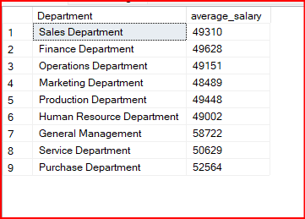

Slide 7

C) Class Intervals:
Project Description: We have to find the class interval is the difference between the upper class limit and the lower class limit.
Approach: In order to do the task, I have taken offered salary column I have used concat function and I have taken 10000 as limit and perform the action
Command to execute:
SELECT CONCAT('Rs', FLOOR(offered_salary/10000)*10000, ' -Rs' (FLOOR(offered_salary/10000)+1)*10000-1) AS SalaryInterval, COUNT(*) AS Frequency
FROM [dbo].[Statistics.xlsx - Sheet1]
GROUP BY FLOOR(offered_salary/10000);

Slide 8

cont
Tech Stack used: MySQL Command Client 8.0
Insights: By running this query, we will find the class interval of the class.

Slide 9
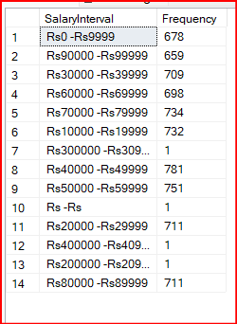

Slide 10

D) Charts and Plots:
Project Description: By drawing the graph we have to show proportion of people working different department .
Approach: In order to do the task, I have used matplotlib to draw the graph for the people working different department and pandas to calculate in different categories in department.

Slide 11
CONT
Command to execute:
import pandas as pd
import matplotlib.pyplot as plt
df=pd.read_csv(r"C:\Users\91812\Dropbox\PC\Downloads\Statistics.csv")
from sklearn.preprocessing import LabelEncoder
le = LabelEncoder()
label = le.fit_transform(df['Department'])
s=df['Department'].unique()
s.sort()
dup=list(df['Department'])
vals=[]
for i in s:
vals.append(dup.count(i))
plt.pie(vals,labels=s,autopct="%.2f")

Slide 12

CONT
Tech Stack used: JUPYTER NOTEBOOK
Insights: By running this query, we will find the graph of the department .

Slide 13
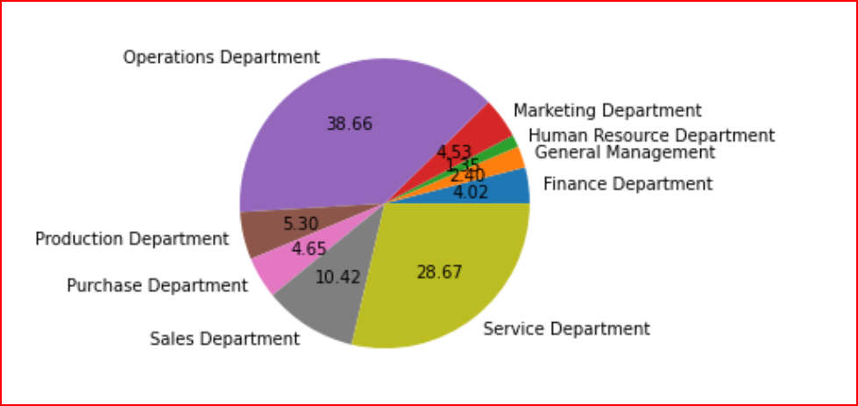

Slide 14

E) Charts:
Project Description: By drawing the graph we have to show proportion of people working different post tiers .
Approach: In order to do the task, I have used matplotlib to draw the graph for the people working different department and pandas to calculate in different categories in department.

Slide 15

cont
Command to execute:
import pandas as pd
import matplotlib.pyplot as plt
df=pd.read_csv(r"C:\Users\91812\Dropbox\PC\Downloads\Statistics.csv")
s=df['Post Name'].unique()
s.sort()
dup=list(df['Post Name'])
vals=[]
for i in s:
vals.append(dup.count(i))
plt.pie(vals,labels=s,autopct="%.2f")

Slide 16
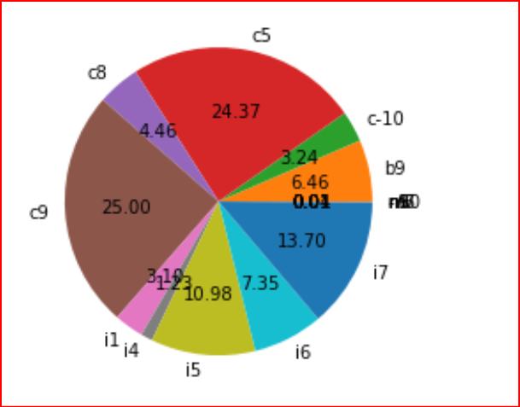

Slide 17
cont
Tech Stack used: JUPYTER NOTEBOOK
Insights: By running this query, we will find the graph of the department .

Slide 18

THANK YOU

